Slide 2
Walkthrough
Netflix viewing trend

Slide 3
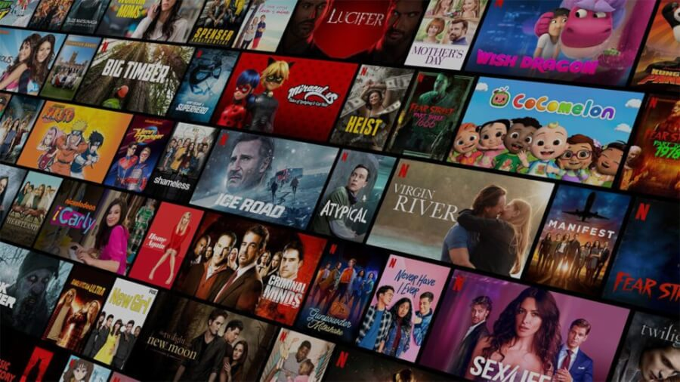
Netflix is an internet streaming platform that offers wide variety of award-winning TV shows, movies, anime, documentaries, and more on thousands of internet-connected devices. INITIALLY IT was founded in 1997 by Reed Hastings and Marc Randolph as a DVD rental-by-mail service but gradually TRANSFORMED into a streaming platform. I myself analyzed the growth trend and the content strategy of Netflix in respect to demographics, Content, and customer segmentation.

Slide 4
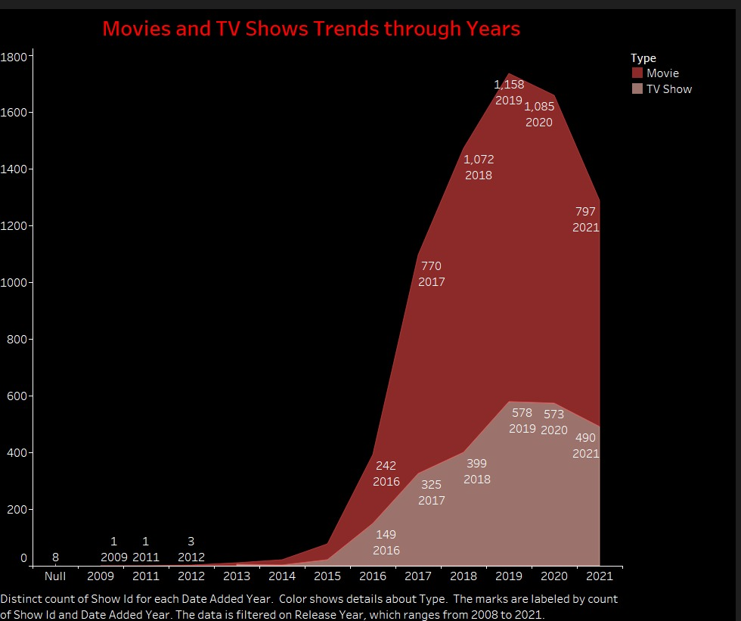
Movies ACE TV SHOWS BY HUGE MARGINS
Its almost a decade the release of movies annually have surpassed the release of TV shows annually. The numbers pitfall during the Pandemic Era for both cases due to social isolations were in effect.
The trend illustrates viewers feels mundane for prolonged TV shows over a time than they do for movies which usually wraps up in short hours.

Slide 5
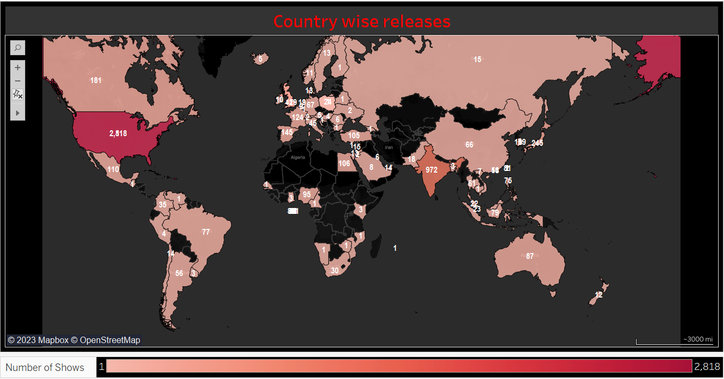
USA & INDIA ARE THE HOTSPOTS for Netflix
USA and India turn out to be the top two nations where Netflix has the highest number of content releases and makes most of its revenue share. whereas other countries like Egypt, Saudi Arabia, China, Pakistan, and Russia occupy a small portion of the total share could possibly be reasons for social media restrictions, and government impositions on broadcasting.
Interestingly most of the African nations and Central Asian nations where Netflix is yet to debut are also due to cultural or social obligations or maybe a strategical phase-wise global expansion policy.

Slide 6
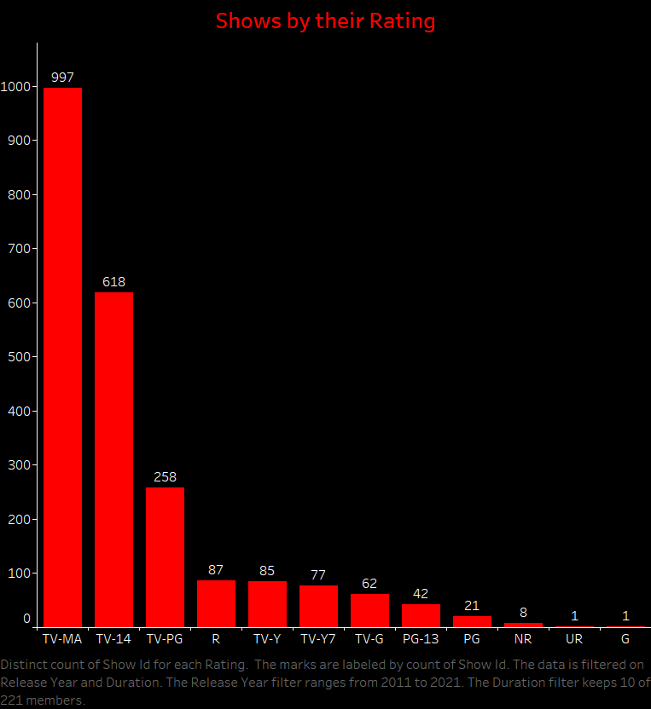
MORE MATURE CONTENT IS BEING RELEASED AS LITTLE CENSORSHIP HURDLES
The viz shows mostly the viewers of Netflix are older folks who are youth or elderly people than children or kids, who prefers specific rated shows and their content is therefore flooded over the netflix platform.

Slide 7
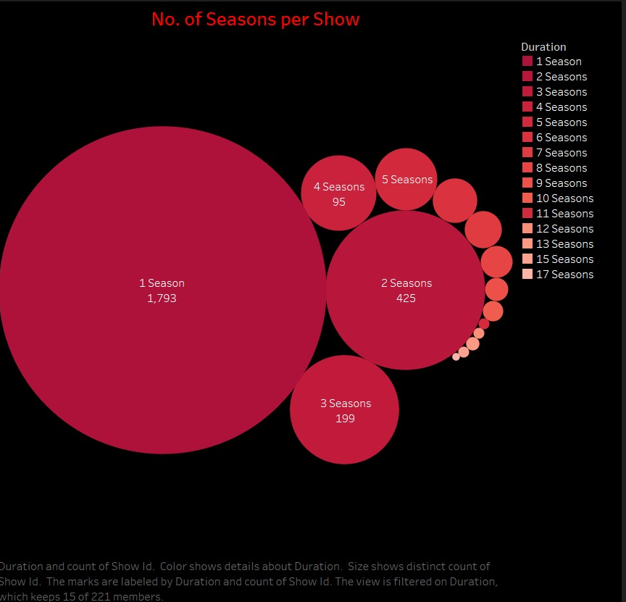
THE TV SHOWS ARE HARDLY BEYOND 2-3 SEASONS
In a fast-revolutionizing era where people prefer reels over videos, emojis & memojis over comments, likewise lengthier seasons tv shows are now ousted by single or max 2 or 3 seasons tv shows.

Slide 8
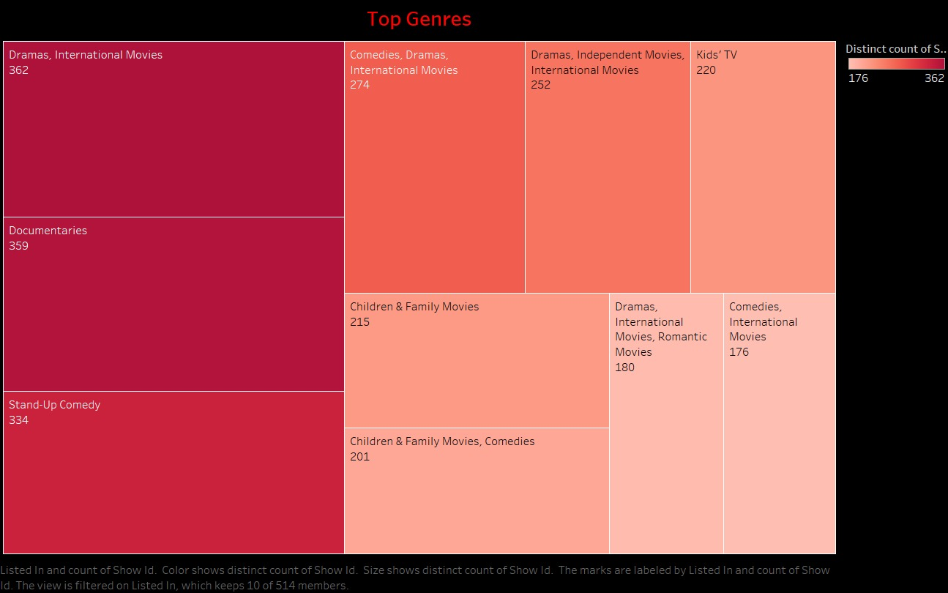
Drama & Documentaries tops Viewer’s choice, NEW GENRES CATCHING UP
The following viz establish the fact that most of the content being released is “Drama, International Movies” with almost the same quantum being shared by “Documentaries” with a total count of 362 and 359 behind it.
” Stand-Up Comedy” is as expected loved by the public and is a focus of Netflix’s Content creation strategy. We can see that the traditional genres like “Dramas” and “Documentary” are as focused as the newer genres like “Stand-Up “Comedy.

Slide 9
CONCLUSION
To summarize, the visualization of the Netflix data tells us insights into Netflix’s Content Strategy and its demographic and geographic footprint.
Netflix’s content strategy has been tapping into big economies and population hotspots and its demographic focus has been the matured audience
The traditional genres still dominate but newer genres like Stand-Up Comedy is Catching Up
An increased focus on lesser-span TV shows and movies seems to indicate a change in people’s preferences.

